Slide 1
A Hybrid Rule-Based NLP and Machine Learning Approach for PII Detection and Anonymization in Financial Documents
MUSTAFA CAN ÇALIŞKAN, 504251544
BLG 640E - Security in Financial Information Systems
K. Mishra, H. Pagare, and K. Sharma, “A hybrid rule-based NLP and machine learning approach for PII detection and anonymization in financial documents,” Scientific Reports, vol. 15, 2025.

Slide 2

WHY THIS TOPIC IS IMPORTANT
Financial documents contain sensitive personal information
Examples include names, emails, phone numbers, addresses, SSNs, and credit card numbers
Data leaks can cause financial loss, legal penalties, and loss of trust
Companies must protect customer data and follow privacy regulations
So, automatic PII detection is very important in finance

Slide 3
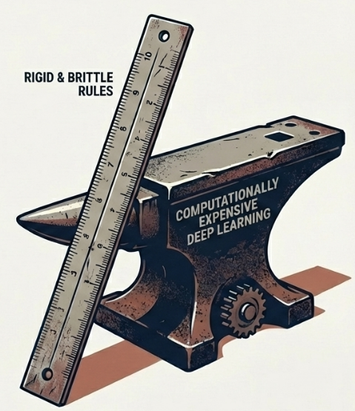
STATE OF THE ART
Rule-based and regex methods are simple and fast
But they often fail on complex and unstructured documents
Machine learning methods improve detection, but they may not generalize well
Deep learning models can be accurate, but they need high computation and large labeled datasets
The main need is a system that is accurate, scalable, and practical

Slide 4
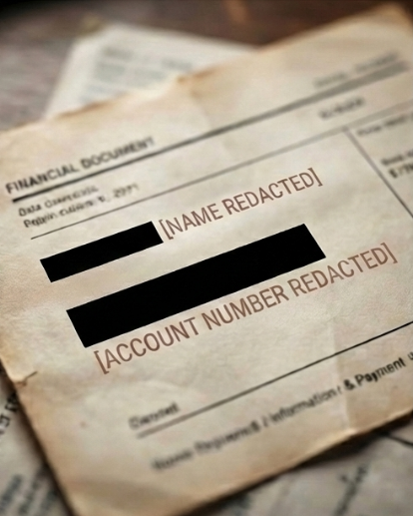
MAIN GOAL OF THE PAPER
The paper proposes a hybrid system for PII detection and anonymization
It combines rule-based NLP and machine learning
It uses a custom spaCy NER model
The aim is to detect sensitive data and replace it with safe placeholders
The system tries to protect privacy without damaging document meaning

Slide 5
METHODOLOGY
Synthetic financial text was created with Faker-based PII generation
PII entities were annotated and used to train a custom spaCy NER model
Raw financial text was preprocessed before detection
Hybrid detection combined regex rules with the trained NER model
Detected PII was anonymized with secure placeholders

Slide 6
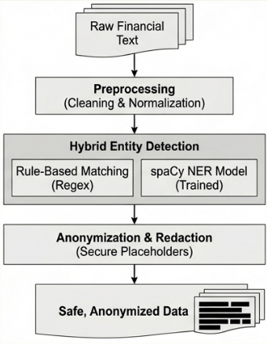
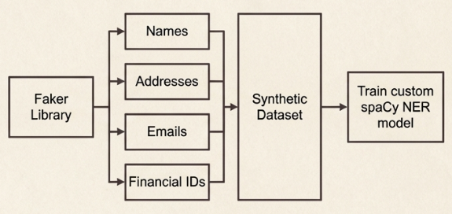
METHODOLOGY

Slide 7
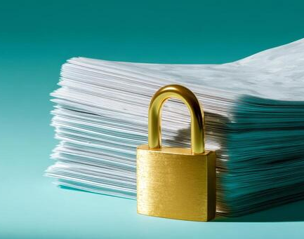
CONTRIBUTIONS OF THE PAPER
It focuses specifically on financial documents
It builds a hybrid NLP and ML pipeline instead of using only one method
It preserves semantic meaning during anonymization
It uses realistic synthetic financial data for training
It also validates the model on real-world financial documents

Slide 8
EXAMPLE OUTPUTS
The model replaces sensitive information with clear placeholders
It can anonymize audit reports, invoices, and transaction-related text
It keeps the document readable and useful
This is important for compliance, auditing, and secure data sharing

Slide 9
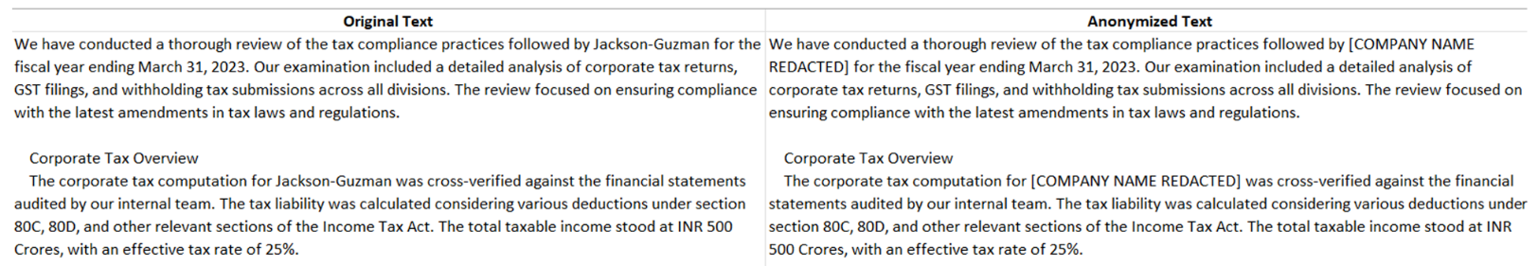
EXAMPLE OUTPUTS

Slide 10
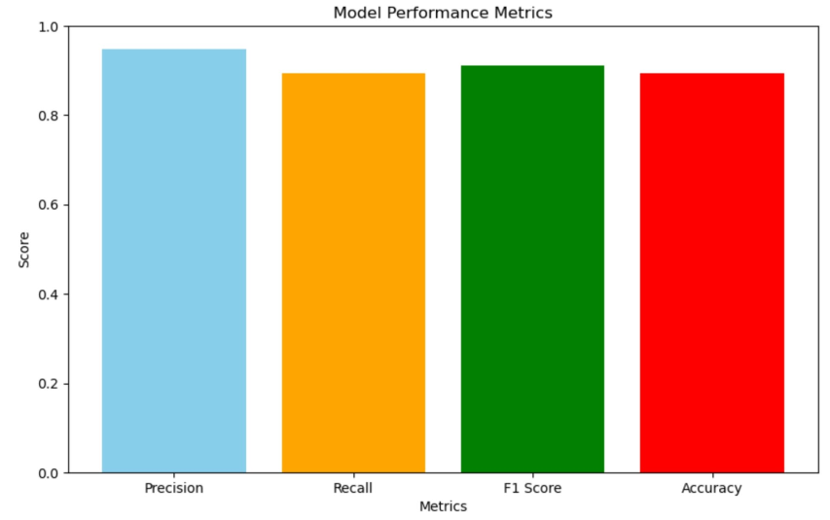
RESULTS
Precision: 94.7%, Recall: 89.4%, F1-score: 91.1%, Synthetic-data accuracy: 89.4%, Real-world accuracy: about 93%
These results show that the model detects most PII types effectively and also works well on real financial documents

Slide 11
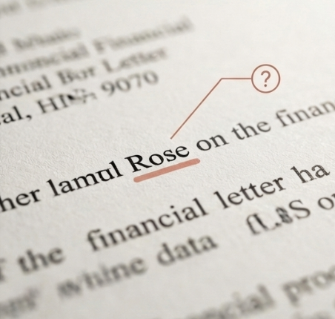
CHALLENGES AND LIMITATIONS
URLs were harder to detect than other PII types
Credit card numbers also caused some false negatives
Some names can be confused with common words
Synthetic data is useful, but it cannot cover every real-world case
More real anonymized financial data could improve the model

Slide 12
CONCLUSION
The paper presents a practical and scalable solution for PII protection in financial documents
Its main strength is combining privacy protection with document usability
The hybrid approach performs better than many traditional methods
It is also more practical than heavy deep learning solutions in some cases
Future work includes more real data and multilingual support

Slide 13
THANKS FOR LISTENING!

